Slide 1

Vežba 8
II princip termodinamike
Termodinamika sa termotehnikom

Slide 2
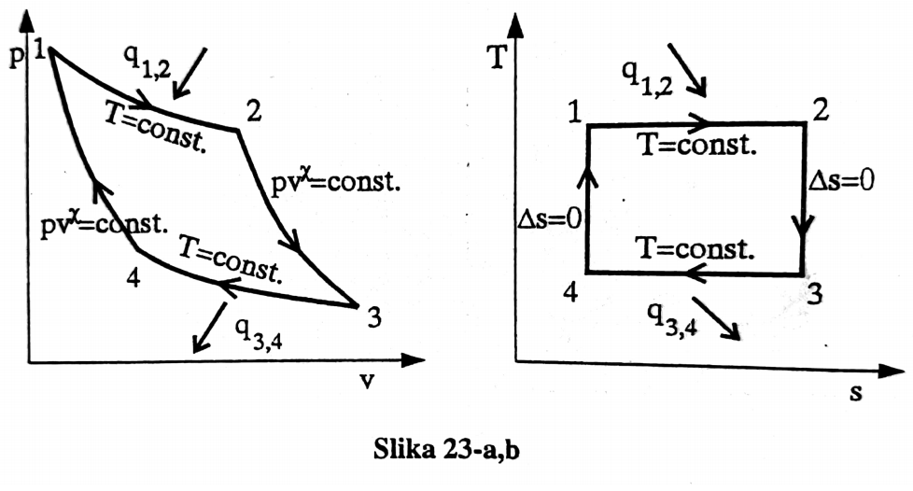

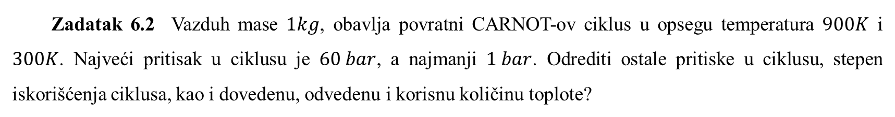
Zadatak 6.2 Vazduh mase $1kg$, obavlja povratni CARNOT-ov ciklus u opsegu temperatura $900K$ i $300K$. Najveći pritisak u ciklusu je $60 bar$, a najmanji $1 bar$. Odrediti ostale pritiske u ciklusu, stepen iskorišćenja ciklusa, kao i dovedenu, odvedenu i korisnu količinu toplote?
$$T_{3}=T_{4}=T_{0}=300\left[K\right]$$
$$T_{1}=T_{2}=T=900\left[K\right]$$
$$p_{1}=60 bar$$
$$p_{3}=1 bar$$
$$η_{tc}=?$$

Slide 3

$$p_{2}^{1−χ}T_{2}^{χ}=p_{3}^{1−χ}T_{3}^{χ}$$
$$p_{2}=p_{3}{\left(\frac{T_{3}}{T_{2}}\right)}^{\frac{χ}{1−χ}}⇒p_{2}=1\left[bar\right]∙{\left(\frac{300}{900}\right)}^{\frac{1,4}{1−1,4}}=46,76\left[bar\right]$$
$$p_{4}=p_{1}{\left(\frac{T_{1}}{T_{4}}\right)}^{\frac{χ}{1−χ}}⇒p_{4}=60\left[bar\right]∙{\left(\frac{900}{300}\right)}^{\frac{1,4}{1−1,4}}=1,28\left[bar\right]$$
$$T_{3}=T_{4}=T_{0}$$
$$T_{1}=T_{2}=T$$
$$η_{tc}=\frac{T−T_{0}}{T}=\frac{900−300}{900}=0,66$$

Slide 4
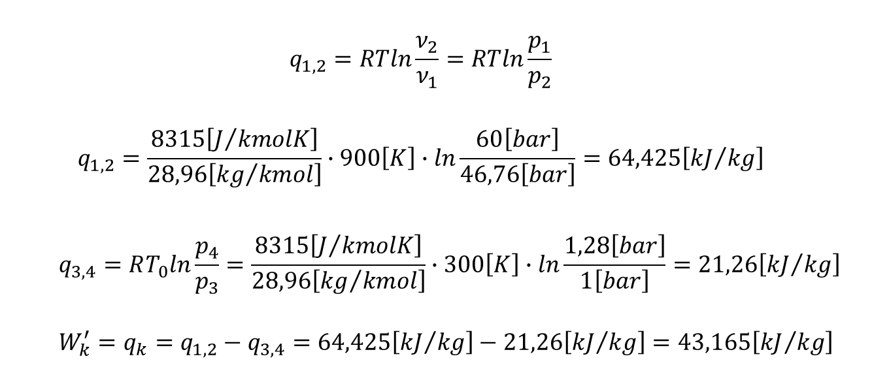
$$q_{1,2}=RTln\frac{ν_{2}}{ν_{1}}=RTln\frac{p_{1}}{p_{2}}$$
$$q_{1,2}=\frac{8315\left[J/{kmolK}\right]}{28,96\left[{kg}/{kmol}\right]}∙900\left[K\right]∙ln\frac{60\left[bar\right]}{46,76\left[bar\right]}=64,425\left[{kJ}/{kg}\right]$$
$$q_{3,4}=RT_{0}ln\frac{p_{4}}{p_{3}}=\frac{8315\left[J/{kmolK}\right]}{28,96\left[{kg}/{kmol}\right]}∙300\left[K\right]∙ln\frac{1,28\left[bar\right]}{1\left[bar\right]}=21,26\left[{kJ}/{kg}\right]$$
$$W_{k}^{′}=q_{k}=q_{1,2}−q_{3,4}=64,425\left[{kJ}/{kg}\right]−21,26\left[{kJ}/{kg}\right]=43,165\left[{kJ}/{kg}\right]$$

Slide 5
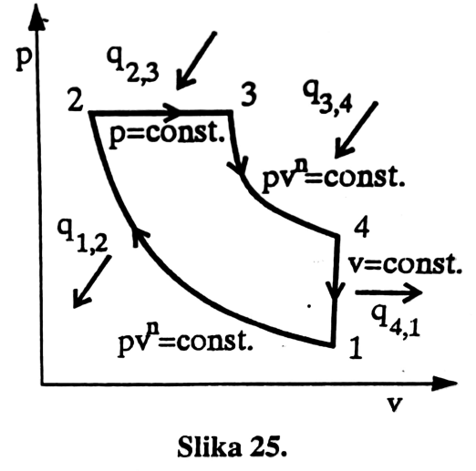
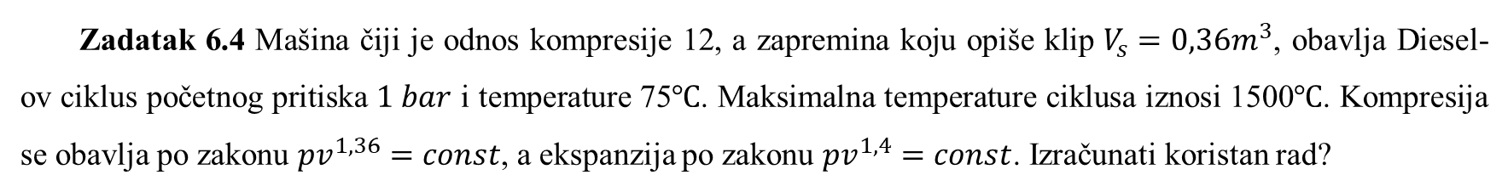

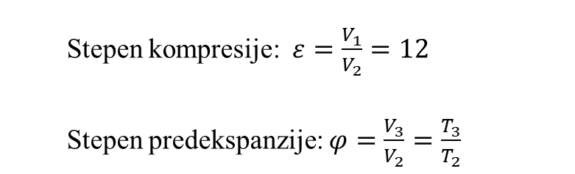
Zadatak 6.4 Mašina čiji je odnos kompresije 12, a zapremina koju opiše klip $V_{s}=0,36m^{3}$, obavlja Diesel-ov ciklus početnog pritiska $1 bar$ i temperature 75$℃$. Maksimalna temperature ciklusa iznosi 1500$℃$. Kompresija se obavlja po zakonu ${pv}^{1,36}=const$, a ekspanzija po zakonu ${pv}^{1,4}=const$. Izračunati koristan rad?
$$T_{3}=1773\left[K\right]$$
$$T_{1}=348\left[K\right]$$
$$p_{1}=1 bar$$
$$V_{s}=0,36m^{3}$$
$${pv}^{1,36}=const$$
$${pv}^{1,4}=const$$
$$W_{k}=?$$
Stepen kompresije: $ε=\frac{V_{1}}{V_{2}}=12$
Stepen predekspanzije:$φ=\frac{V_{3}}{V_{2}}=\frac{T_{3}}{T_{2}}$

Slide 6

$$W_{k}=W_{2,3}+W_{3,4}−W_{1,2}$$
$$W_{2,3}=p\left(V_{3}−V_{2}\right)$$
$$W_{3,4}=m\frac{R}{n_{34}−1}\left(T_{4}−T_{3}\right)=\frac{R}{n_{34}−1}\left(p_{4}V_{4}−p_{3}V_{3}\right)$$
$$W_{1,2}=m\frac{R}{n_{12}−1}\left(T_{2}−T_{1}\right)=\frac{1}{n_{12}−1}\left(p_{2}V_{2}−p_{1}V_{1}\right)$$
$$ε=\frac{V_{1}}{V_{2}}=12 ⇒ \frac{V_{1}}{V_{2}}=\frac{V_{2}+V_{s}}{V_{2}}=1+\frac{0,36}{V_{2}}=12$$
$$V_{2}=0,0327\left[m^{3}\right]⇒{V_{1}=12V}_{2}=0,392\left[m^{3}\right]$$

Slide 7
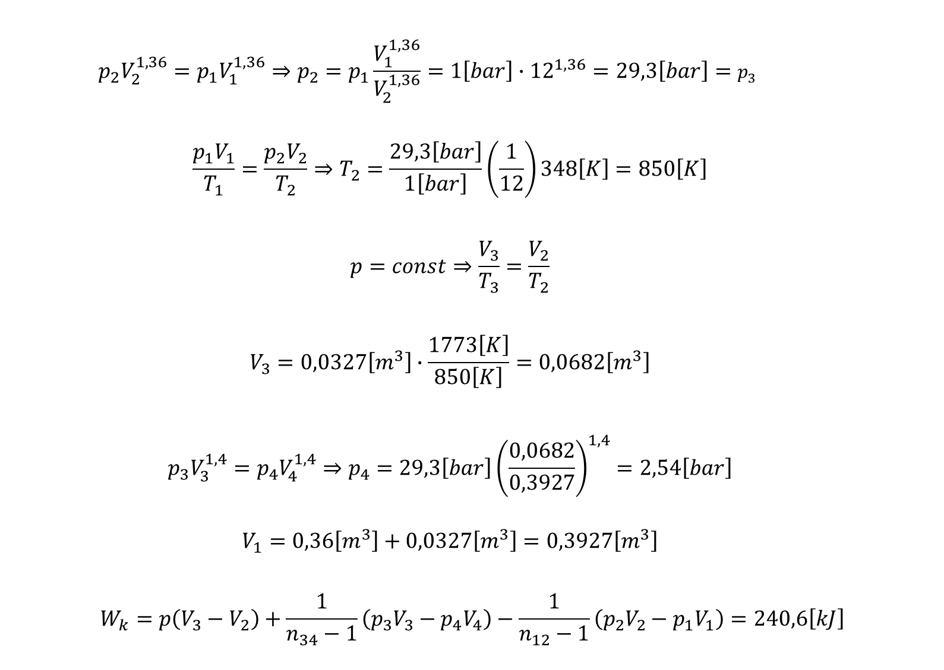
$$p_{2}V_{2}^{1,36}=p_{1}V_{1}^{1,36}⇒p_{2}=p_{1}\frac{V_{1}^{1,36}}{V_{2}^{1,36}}=1\left[bar\right]∙{12}^{1,36}=29,3\left[bar\right]=p_{3}$$
$$\frac{p_{1}V_{1}}{T_{1}}=\frac{p_{2}V_{2}}{T_{2}}⇒T_{2}=\frac{29,3\left[bar\right]}{1\left[bar\right]}\left(\frac{1}{12}\right)348\left[K\right]=850\left[K\right]$$
$$p=const⇒\frac{V_{3}}{T_{3}}=\frac{V_{2}}{T_{2}}$$
$$V_{3}=0,0327\left[m^{3}\right]∙\frac{1773\left[K\right]}{850\left[K\right]}=0,0682\left[m^{3}\right]$$
$$p_{3}V_{3}^{1,4}=p_{4}V_{4}^{1,4}⇒p_{4}=29,3\left[bar\right]{\left(\frac{0,0682}{0,3927}\right)}^{1,4}=2,54\left[bar\right]$$
$$V_{1}=0,36\left[m^{3}\right]+0,0327\left[m^{3}\right]=0,3927\left[m^{3}\right]$$
$$W_{k}=p\left(V_{3}−V_{2}\right)+\frac{1}{n_{34}−1}\left(p_{3}V_{3}−p_{4}V_{4}\right)−\frac{1}{n_{12}−1}\left(p_{2}V_{2}−p_{1}V_{1}\right)=240,6\left[kJ\right]$$

Slide 8
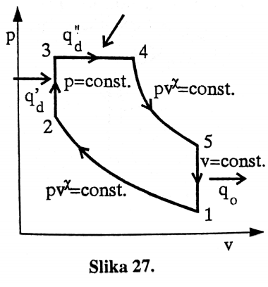
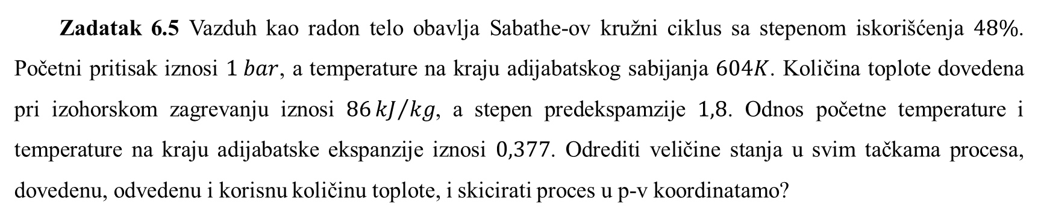
Zadatak 6.5 Vazduh kao radon telo obavlja Sabathe-ov kružni ciklus sa stepenom iskorišćenja $48\%$. Početni pritisak iznosi $1 bar$, a temperature na kraju adijabatskog sabijanja $604K$. Količina toplote dovedena pri izohorskom zagrevanju iznosi $86{kJ}/{kg}$, a stepen predekspamzije $1,8$. Odnos početne temperature i temperature na kraju adijabatske ekspanzije iznosi $0,377$. Odrediti veličine stanja u svim tačkama procesa, dovedenu, odvedenu i korisnu količinu toplote, i skicirati proces u p-v koordinatamo?

Slide 9

$$q_{d}^{′}=c_{v}\left(T_{3}−T_{2}\right)=\frac{C_{v}}{M}\left(T_{3}−T_{2}\right)$$
$$T_{3}=T_{2}+q_{d}^{′}\frac{M}{C_{v}}$$
$$T_{3}=604\left[K\right]+86\left[\frac{kJ}{kg}\right]\frac{28,96\left[\frac{kJ}{kmol}\right]}{20,8\left[\frac{kJ}{kmolK}\right]}=732,74 \left[K\right]$$
$$T_{4}=φ∙T_{3}=1,8∙723,74=1302,73\left[K\right]$$
$$q_{d}^{"}=\frac{C_{p}}{M}\left(T_{4}−T_{3}\right)=\frac{29,1\left[{kJ}/{kmolK}\right]}{28,96\left[{kg}/{kmol}\right]}\left(1302,73−732,74\right)\left[K\right]=581,8\left[{kJ}/{kg}\right]$$
$$\frac{q_{d}^{′}+q_{d}^{"}−q_{0}}{q_{d}^{′}+q_{d}^{"}}=0,48 ⇒ q_{0}=347,3\left[{kJ}/{kg}\right]$$

Slide 10
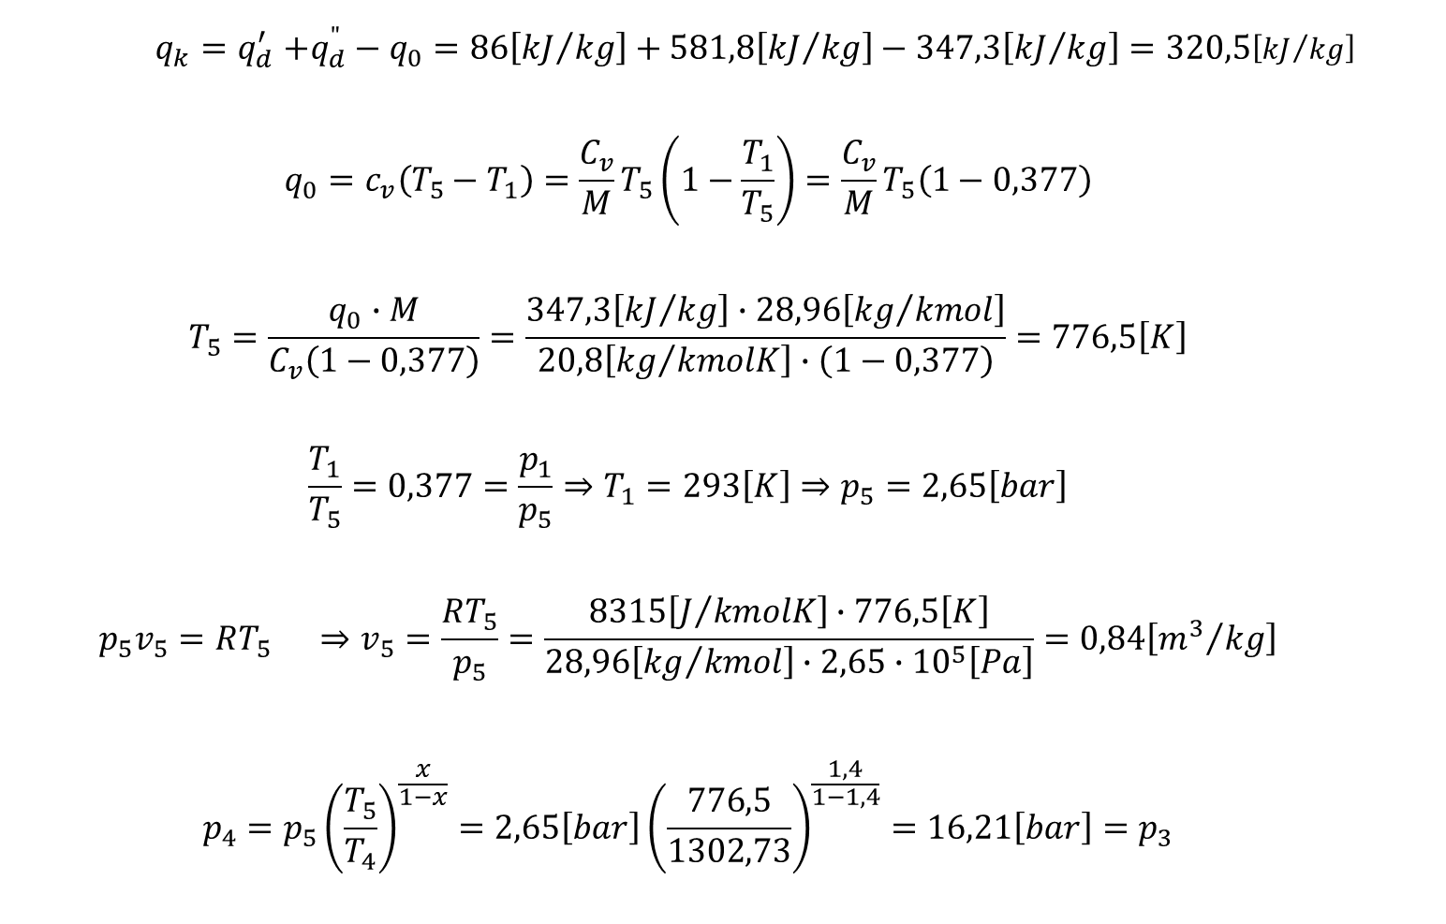
$$q_{k}{=q}_{d}^{′}+q_{d}^{"}−q_{0}=86\left[{kJ}/{kg}\right]+581,8\left[{kJ}/{kg}\right]−347,3\left[{kJ}/{kg}\right]=320,5\left[{kJ}/{kg}\right]$$
$$q_{0}=c_{v}\left(T_{5}−T_{1}\right)=\frac{C_{v}}{M}T_{5}\left(1−\frac{T_{1}}{T_{5}}\right)=\frac{C_{v}}{M}T_{5}\left(1−0,377\right)$$
$$T_{5}=\frac{q_{0}∙M}{C_{v}\left(1−0,377\right)}=\frac{347,3\left[{kJ}/{kg}\right]∙28,96\left[{kg}/{kmol}\right]}{20,8\left[{kg}/{kmolK}\right]∙\left(1−0,377\right)}=776,5\left[K\right]$$
$$\frac{T_{1}}{T_{5}}=0,377=\frac{p_{1}}{p_{5}}⇒T_{1}=293\left[K\right]⇒p_{5}=2,65\left[bar\right]$$
$$p_{5}v_{5}=RT_{5} ⇒v_{5}=\frac{RT_{5}}{p_{5}}=\frac{8315\left[J/{kmolK}\right]∙776,5\left[K\right]}{28,96\left[{kg}/{kmol}\right]∙2,65∙{10}^{5}\left[Pa\right]}=0,84\left[{m^{3}}/{kg}\right]$$
$$p_{4}=p_{5}{\left(\frac{T_{5}}{T_{4}}\right)}^{\frac{x}{1−x}}=2,65\left[bar\right]{\left(\frac{776,5}{1302,73}\right)}^{\frac{1,4}{1−1,4}}=16,21\left[bar\right]=p_{3}$$

Slide 11
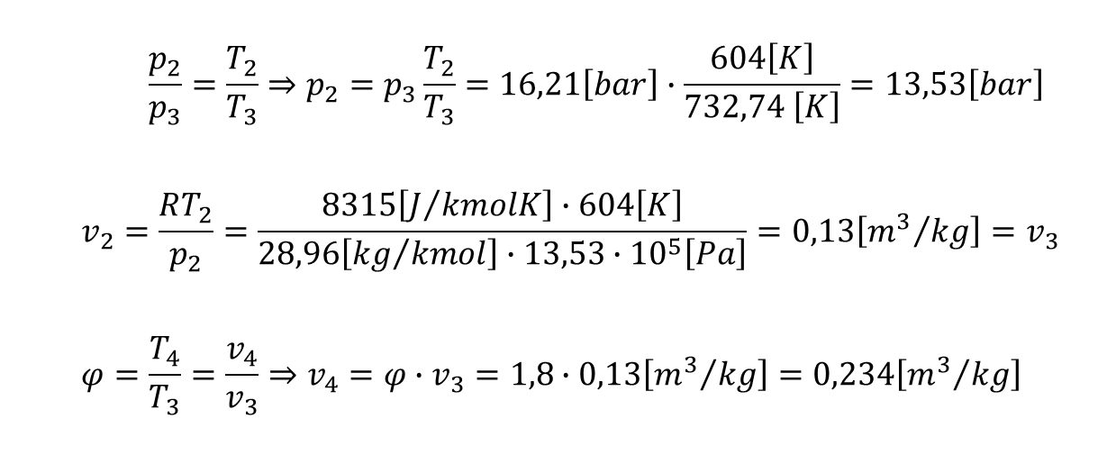
$$\frac{p_{2}}{p_{3}}=\frac{T_{2}}{T_{3}}⇒p_{2}=p_{3}\frac{T_{2}}{T_{3}}=16,21\left[bar\right]∙\frac{604\left[K\right]}{732,74 \left[K\right]}=13,53\left[bar\right]$$
$$v_{2}=\frac{RT_{2}}{p_{2}}=\frac{8315\left[J/{kmolK}\right]∙604\left[K\right]}{28,96\left[{kg}/{kmol}\right]∙13,53∙{10}^{5}\left[Pa\right]}=0,13\left[{m^{3}}/{kg}\right]=v_{3}$$
$$φ=\frac{T_{4}}{T_{3}}=\frac{v_{4}}{v_{3}}⇒v_{4}=φ∙v_{3}=1,8∙0,13\left[{m^{3}}/{kg}\right]=0,234\left[{m^{3}}/{kg}\right]$$

